Slide 1

XNA 3D Primer
Michael C. Neel
ViNull.com
michael.neel@gmail.com

Slide 2
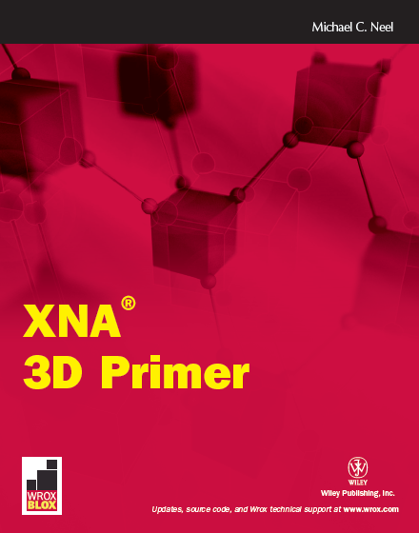
Wrox.com

Slide 3

create.msdn.com
vinull.com

Slide 4
3D Overview

Slide 5

3D Math
Right Hand Rule
Notes:
http://www.flickr.com/photos/rutty/492385781/

Slide 6

3D Math
Matrix.CreateScale
Matrix.CreateRotationX
Matrix.CreateRotationY
Matrix.CreateRotationZ
Matrix.CreateFromAxisAngle
Matrix.CreateFromQuaternion
Matrix.CreateTranslation
Matrix.CreateLookAt
Matrix.CreatePerspective
Matrix.CreatePerspectiveFieldOfView
Matrix.CreatePerspectiveOffCenter
Matrix.CreateOrthographic
Matrix.CreateOrthographicOffCenter
Matrix.CreateWorld
Notes:
http://www.flickr.com/photos/rutty/492385781/

Slide 7
3D Math
Identity
Scale
Rotate
Orbit
Translate
ISROT
Notes:
http://www.flickr.com/photos/rutty/492385781/

Slide 8
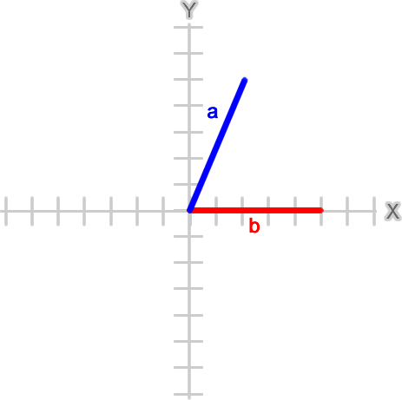
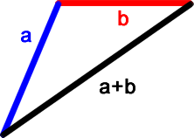
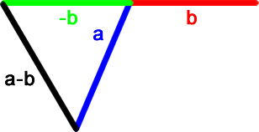
3D Math - Vectors
Notes:
http://www.flickr.com/photos/rutty/492385781/

Slide 9
3D Math – Build a better Arc
Arctangent2 – Math.Atan2
Math.Atan2( 2.0, 4.0)
0.46364760900080609
Math.Atan2( -2.0, -4.0)
-2.677945044588987
Notes:
http://www.flickr.com/photos/rutty/492385781/

Slide 10
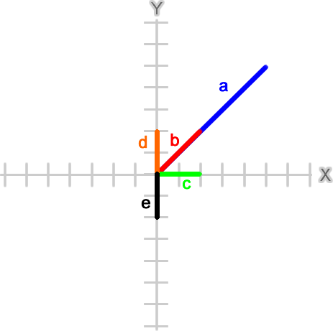
3D Math
Vector3.Dot(Vector3.Normalize(a),
Vector3.Normalize(b))
1.0
Vector3.Dot(Vector3.Normalize(d),
Vector3.Normalize(e))
-1.0
Vector3.Dot(Vector3.Normalize(c),
Vector3.Normalize(d))
0.0
Vector3.Dot(Vector3.Normalize(b),
Vector3.Normalize(c))
0.707106769
Vector3.Dot(Vector3.Normalize(b),
Vector3.Normalize(e))
-0.707106769
Notes:
http://www.flickr.com/photos/rutty/492385781/

Slide 11
3D Math
Math.Acos(
Vector3.Dot(Vector3.Normalize(b),
Vector3.Normalize(c)))
0.78539818051171917
Math.Acos(
Vector3.Dot(Vector3.Normalize(b),
Vector3.Normalize(e)))
2.3561944730780739
Math.Acos(
Vector3.Dot(Vector3.Normalize(b),
Vector3.Normalize(d)))
0.78539818051171917
Math.Acos(
Vector3.Dot(Vector3.Normalize(b),
Vector3.Normalize(c)))
0.78539818051171917
Notes:
http://www.flickr.com/photos/rutty/492385781/

Slide 12
3D Math
Vector3.Cross(b, d)
{X:0 Y:0 Z:4}
Vector3.Cross(b, c)
{X:0 Y:0 Z:-4}
Math.Acos(
Vector3.Dot(Vector3.Normalize(b),
Vector3.Normalize(c)))
* Math.Sign(Vector3.Cross(b, c).Z)
-0.78539818051171917
Notes:
http://www.flickr.com/photos/rutty/492385781/

Slide 13
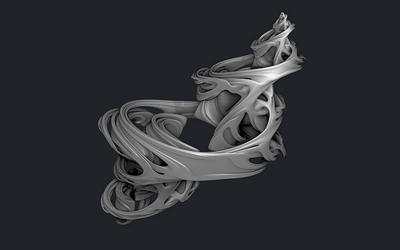
3D Math
Quaternions
Notes:
http://www.flickr.com/photos/subblue/3941924561/

